Slide 1

Smart CO₂ Monitoring & MOF
Simulation
PRESENTED BY :
Hack Divas
Nighaar Taneem
P.Sravika
M.Sreehaasa

Slide 2

Introduction
  CO₂ levels are increasing rapidly and impact climate change
  Monitoring CO₂ in real environments is difficult and costly
  Carbon capture technologies like MOFs are emerging but not well understood
  This project introduces a software-based system to visualize CO₂ monitoring and capture behavior
  Focuses on awareness, education, and planning before real deployment

Slide 3
PROBLEM STATEMENT
  CO₂ concentration values (ppm) are not easily understood by the public
  Real-time CO₂ monitoring infrastructure is expensive
  Working of MOF-based carbon capture systems is not clearly visualized
  Policymakers lack simple tools to analyze impact before large-scale deployment
  Need for a transparent and explainable monitoring system

Slide 4
Objectives
  To simulate CO₂ monitoring across different environments
  To visualize how MOF-based capture reduces CO₂ levels
  To demonstrate sensor-like behavior without physical hardware
  To provide clear before-and-after CO₂ comparison
  To design a system that is scalable and future-ready

Slide 5
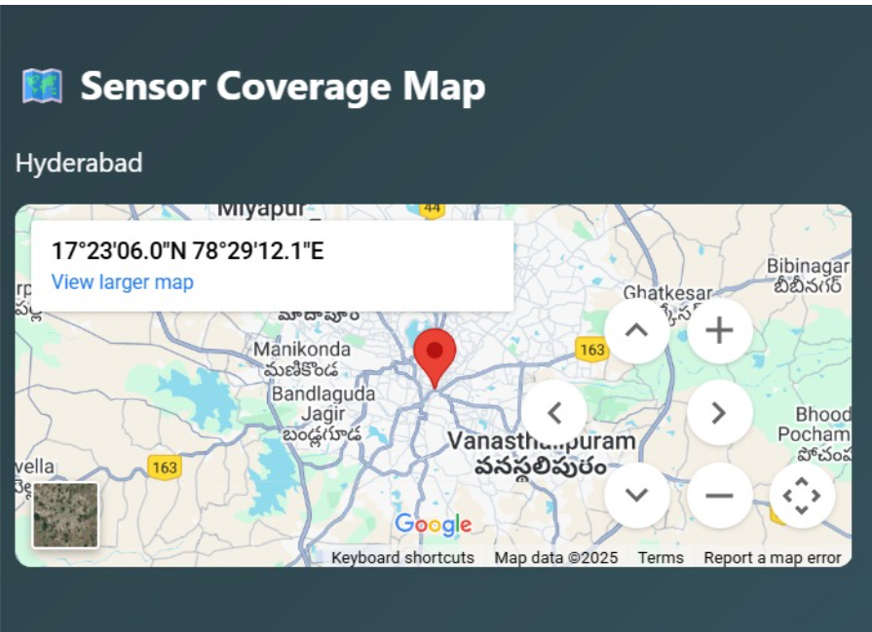
LOCATION BASED MONITORING
  CO₂ monitoring is performed based on geographic location
  City-level monitoring is simulated (Hyderabad)
  Sensor coverage is visualized
using a map interface
  Represents how sensors can be
deployed across different areas
  Helps understand spatial variation
of CO₂ levels
  Supports planning for large-scale,
  real-world deployment

Slide 6
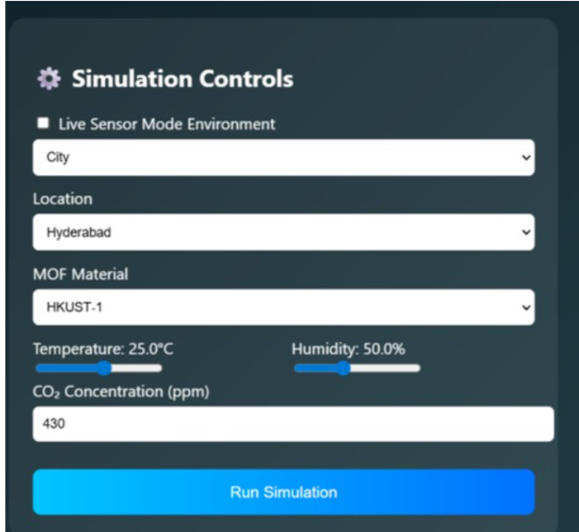
Methodolgy
  Use predefined environment-based CO₂ baseline values
  Simulate live CO₂ sensor behavior with time-based updates
  Apply fixed MOF capture efficiency logic
  Calculate CO₂ levels before and after capture
  Visualize data using charts and indicators
  Estimate near-future CO₂ trends using prediction logic

Slide 7
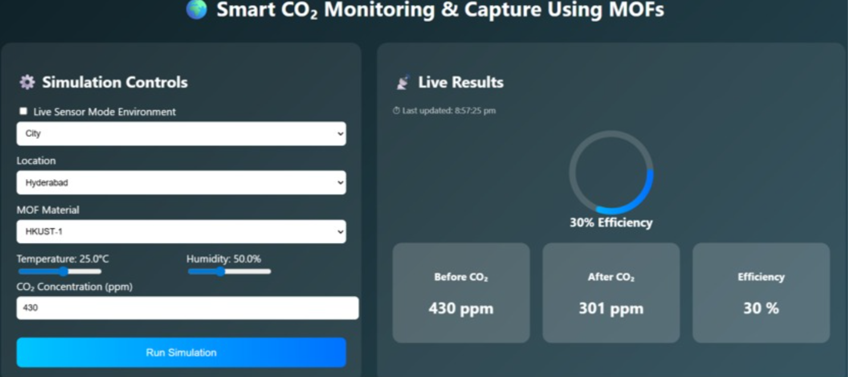
Implementation
  User selects an environment (classroom, traffic, residential, industrial)
  System loads corresponding base CO₂ values
  Simulated sensor generates live CO₂ updates
  User triggers MOF
capture simulation
  MOF efficiency logic is
applied
  Updated CO₂ values are
calculated
  Results are displayed on
real-time dashboards

Slide 8
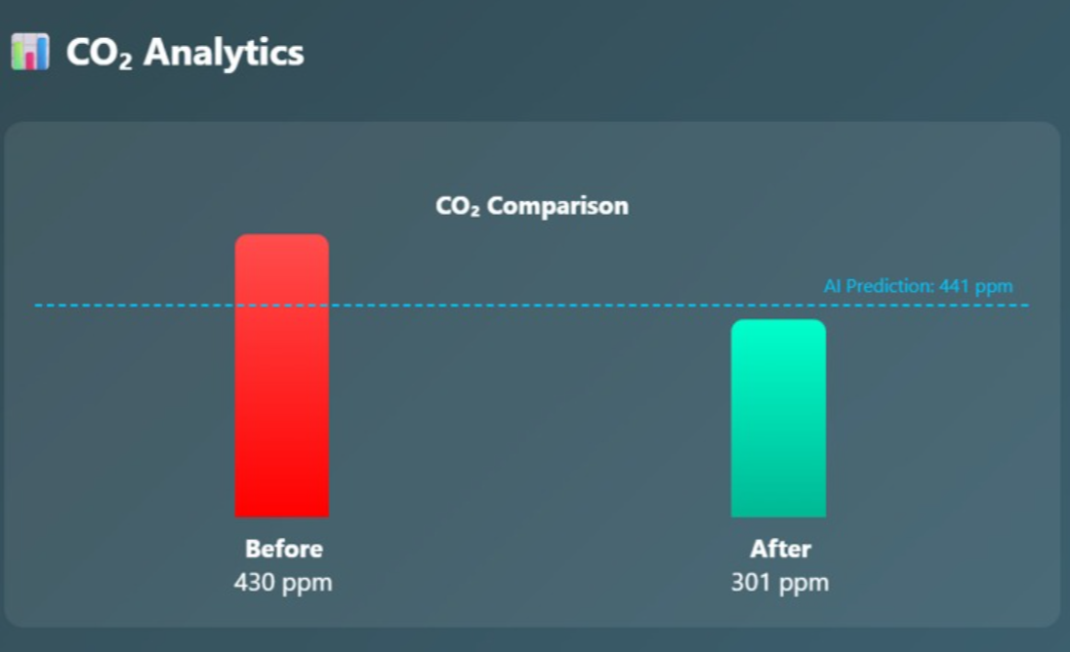
Result
  Clear visualization of CO₂ levels across environments
  Visible CO₂ reduction after MOF capture simulation
  Percentage reduction displayed
  CO₂ trend charts show variation over time
  Prediction line estimates upcoming CO₂ values
  Alerts indicate high CO₂ conditions

Slide 9
Conclusion
  Successfully demonstrates CO₂ monitoring using a simulation-based system
  Clearly visualizes the impact of MOF-based CO₂ capture
  Provides transparent and honest system behavior without real sensors or AI
  Supports education, planning, and policy evaluation
  Designed with a scalable architecture for future real-world deployment

Slide 10
Thank You

